Slide 1
Great Science versus Viable Technology?
Class goal is to prepare YOU to judge new NanoSCIENCE & NanoTECHNOLOGY
But it's not just a question of cold hard facts, the key word is judgment
And I realized that for this I really needed to adjust your level of skepticism
WHY? Science is generally taught in the PAST TENSE
But Nanoscience is PRESENT TENSE
It is going on right now!
Does that make it more exciting? Absolutely!
But it also means we lack the benefits of hindsight
It's thus particularly important that we understand scientific process
A Hands-on Introduction to Nanoscience: WeCanFigureThisOut.org/NANO/Nano_home.htm

Slide 2
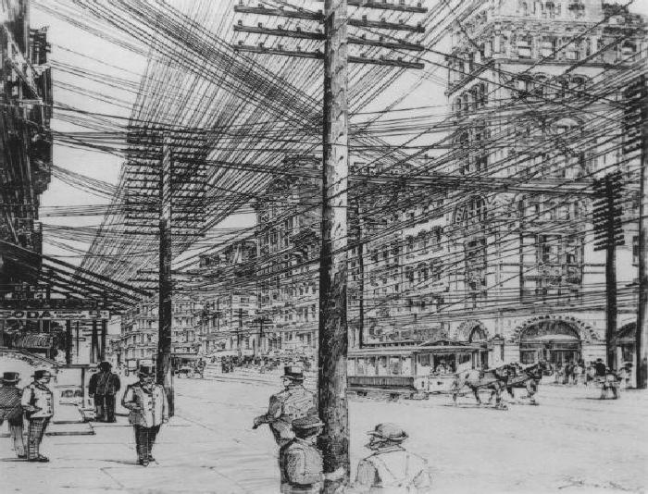
I worked at Bell Labs: Largest most significant R&D lab of the 20th century
Bell Labs was set up after Bell System became a government sanctioned monopoly
Which was allowed because this is what 1890’s New York City looked like
after unrestrained competition between new telephone companies:
A Hands-on Introduction to Nanoscience: WeCanFigureThisOut.org/NANO/Nano_home.htm

Slide 3
Bell Labs factoids:
Bell Lab’s entire budget was paid by surcharge on every customer’s monthly telephone bill
Ma Bell’s employee count reached just under 1,000,000 while I was there (1976-1996)
Bell Labs alone had almost 30,000 employees! Basic research alone had almost 1500!
Think ~ 10 university engineering schools, superbly funded, working on related problems
So Bell Labs’ resources, scope, time horizons were unprecedented!!
Inventions: Transistor, Laser, CCD, UNIX, C, information theory, radio astronomy
Nobel Prizes: 1937 - Davisson - Demonstration of Wave Nature of Matter
1956 - Bardeen, Brattain & Schockley - Transistor
1977 - Anderson - Solid State Theory
1978 - Penzias & Wilson - Proof of the Big Bang
1997 - Steven Chu - Laser Cooling and Trapping of Atoms
1998 - Stormer, Laughlin & Tsui - Fractional Quantum Hall Effect
2009 - Boyle & Smith - CCD digital imaging sensors
2014 – Eric Betzig – PALM Microscopy
Patents: Over 26,000 (of which I contributed 14)

Slide 4
And at Bell Labs I had a rather unusual career path
First 16 years spent as basic researcher and research department head
But spent last 5 years supporting manufacturing plant, doing technology transfer
For Bell Labs, these were RADICALLY different roles:
Research & Manufacturing were deliberately located in separate STATES!
And my people and I didn’t exactly volunteer for that switch:
After break up of the company in 1980’s, it began to fail
They essentially pushed all researchers into development roles
(And, a few years after I left, Bell Labs collapsed)
Nevertheless, this experience:
Gave me rare insight into the differences between Researchers and Developers
A Hands-on Introduction to Nanoscience: WeCanFigureThisOut.org/NANO/Nano_home.htm

Slide 5
Observation #1: Researchers vs. Developers
World class basic researchers MUST be wild-eyed optimists
Their GOAL is to do what no one has ever done before!
And to do this even if "conventional wisdom" says it can't be done!!
STOP - THINK about what this says about researcher’s personality (ego . . .) !
Manufacturing people MUST be cynics
Gravitating toward known, well-proven (= OLD), methods and techniques
Or they would NEVER achieve high-yield production!
Heck, the Sales Dept. would be happy with only ONE NEW THING per product!
And with good enough advertising, ZERO new things could suffice!
Mindsets are so incompatible or even corrosive to one another
that corporate R & D are often separated geographically
(So that researchers don't get TOO practical and developers don't get TOO spacey!)

Slide 6
Consequences?
Putting it bluntly:
Discussing commercial possibilities, researchers have a gaping blind spot
When discussing technology they combine innate optimism with ignorance
And yet researchers are often the public face of a corporation:
As scientists, part of their job is to publicly share results
And management encourages this to bolster technical stature of the company
However, this means that when basic researchers make technology predictions
Predictions should be taken with a HUGE grain of salt
(in ANY field of science!)
A Hands-on Introduction to Nanoscience: WeCanFigureThisOut.org/NANO/Nano_home.htm

Slide 7
Observation #2: Quality of Nanoscience "Peer Review"
The Scientific Method is built around "peer review:"
Before publication, papers must pass review by peer experts
If paper is accepted and published, it's then further critiqued by all readers
This is normally done through very focused (scientifically narrow) publications
Where ~ ALL readers have SOME expertise in the subjects being written about
But Nanoscience is uniquely broad (because we don't yet know where it is going!)
GENERAL SCIENCE publications are therefore preferred (Nature, Science . . .)
All readers are NOT experts - Even all REVIEWERS may not be experts!
Validity of certain Nanoscience papers has been severely questioned
One produced best known case of scientific fraud in recent history!
Problem's exacerbated by modern publication via the web and/or press release
A Hands-on Introduction to Nanoscience: WeCanFigureThisOut.org/NANO/Nano_home.htm

Slide 8
Consequences?
Again putting it bluntly:
Nanoscience publications have a particularly jaded history
They are prone to exaggeration
They often include overlooked omissions or errors
And, occasionally, outright fraud
Further, veracity is also affected by the nature of nanoscience businesses:
HUGE expense of Microfabrication => Big, old, well-established companies
With strong vested interest in protecting their reputation/credibility
Low cost of Nanofabrication => Hundreds of small start-up companies
Some of which may “bend truth” to raise capital and/or stock price
(in order for their start-up to survive a few more months!)

Slide 9
This sets the stage for my discussion of Science vs. Technology:
Researchers deliberately isolated from (and naive about) technology
+
Peer review weakened by breadth of field / self-publication trends / business promotion
=> It's very hard to distinguish valid science from questionable "technology"
And you shouldn't blindly accept "experts" word (including mine)
Yet distinction is essential if are to judge prospects of Nanoscience/technology
So, to sharpen our skills at making such distinctions, let's:
1) Identify boundaries for Microscience/technology (where they are more certain)
2) Then try to do the same for Nano
A Hands-on Introduction to Nanoscience: WeCanFigureThisOut.org/NANO/Nano_home.htm

Slide 10
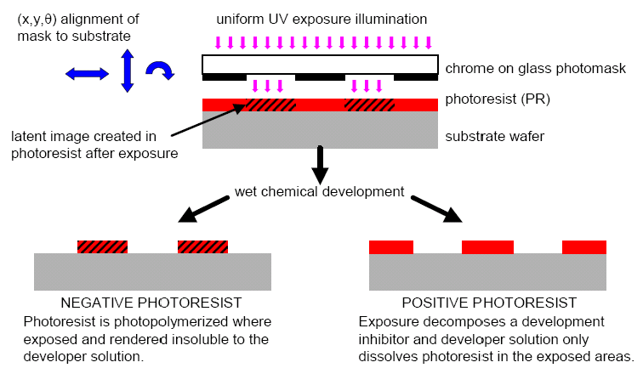
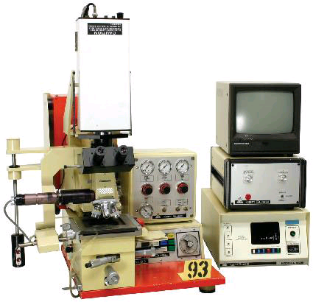
Drawing the distinctions in Microtechnology
Relevant example is "photolithography" - optical micro-patterning
Last class described it schematically:
(UV light through shadow mask
onto polymer "resist" coated wafer)
But what do machines ("tools") really look like and what are they capable of?
Laboratory PHOTO-lithography tools don't look all that different from schematic
Mask and wafer below microscope
Arm at left and knobs below to move wafer to proper position
UV light source (at rear) then directed via mirror through stack
(Karl Suss MJB3-IR w/ thru wafer IR camera: www.bidservice.com)
Source: R. Bruce Darling
University of Washington

Slide 11
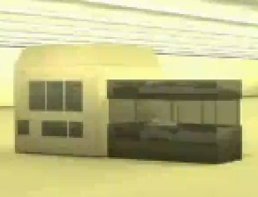
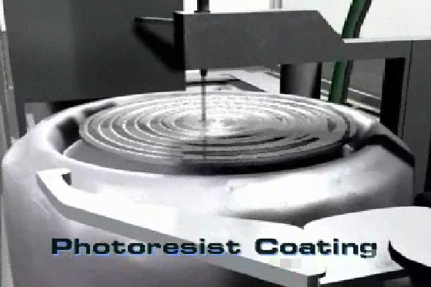
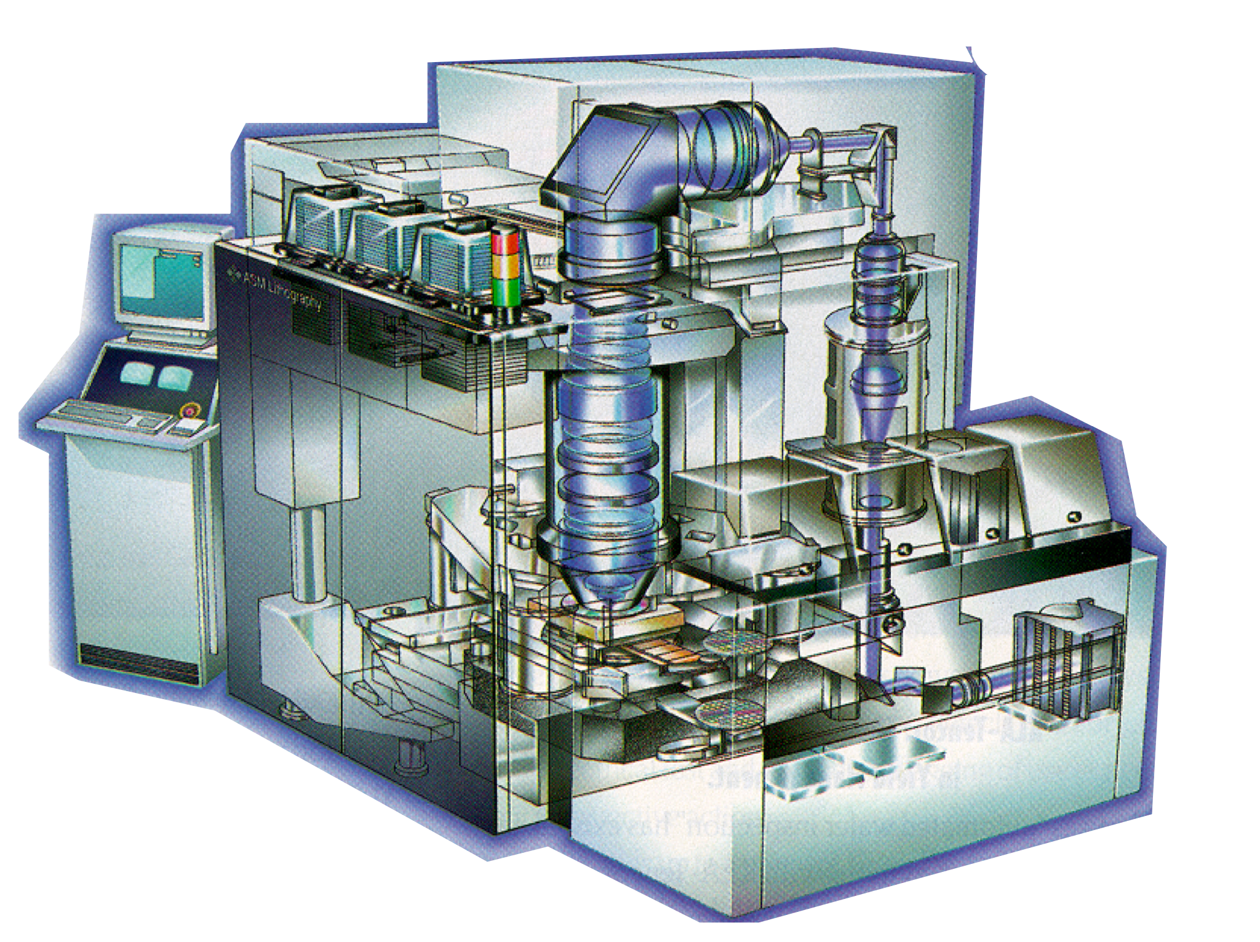
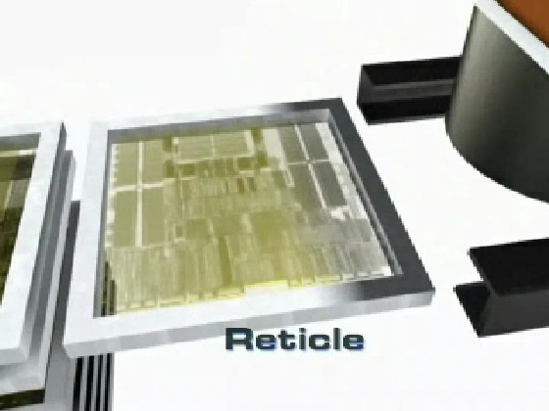
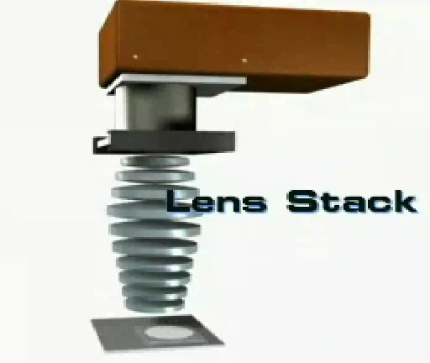
More modern production photolithography tools:
Nikon stepper recreated in virtual reality on
WeCanFigureThisOut.org website:
(https://WeCanFigureThisOut.org/VL/Photolith.htm)
ASML stepper: 248 nm light, 20M$
(www.asml.com)
Both are capable of printing of entire integrated circuit in a single rapid step
Then precisely moving to next circuit and repeating process ("stepping")
Hands-off, fully automated!

Slide 12
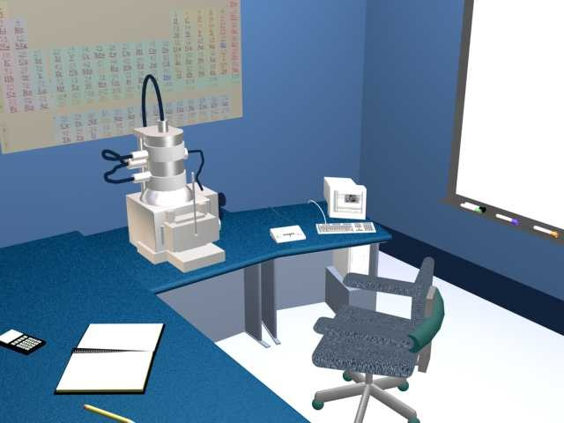
Preceding is CLEARLY technology
But where does boundary get fuzzy?
How are the shadow masks for those tools patterned?
E-Beam Lithography (E stands for electron) - Derived from common SEMs!
Scanning Electron Microscope:
Laboratory workhorse for seeing things
smaller than the wavelength of light
But how does it work?
From https://WeCanFigureThisOut.org/VL/SEM.htm:
A Hands-on Introduction to Nanoscience: WeCanFigureThisOut.org/NANO/Nano_home.htm

Slide 13
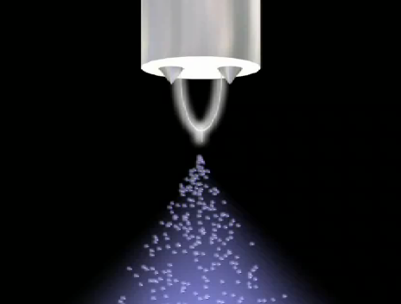
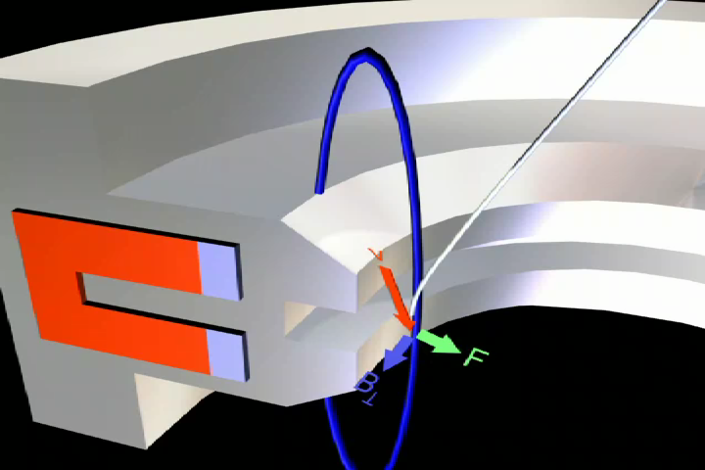
Start by heating metal filament
Then pull electrons off with positive electrode
Diverging electrons pass through bore of cylindrical magnetic lens
Force_{magnetic} = q (v x B)
Electrons spiral 1/2 turn around B field loops
Diverting back toward axis (= focusing)
A Hands-on Introduction to Nanoscience: WeCanFigureThisOut.org/NANO/Nano_home.htm

Slide 14
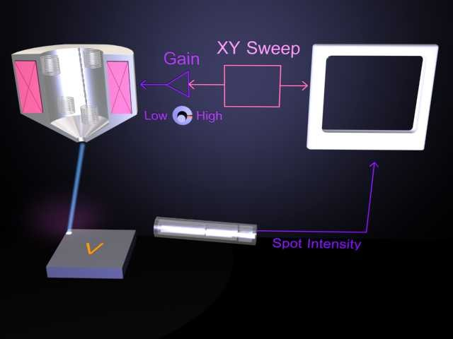
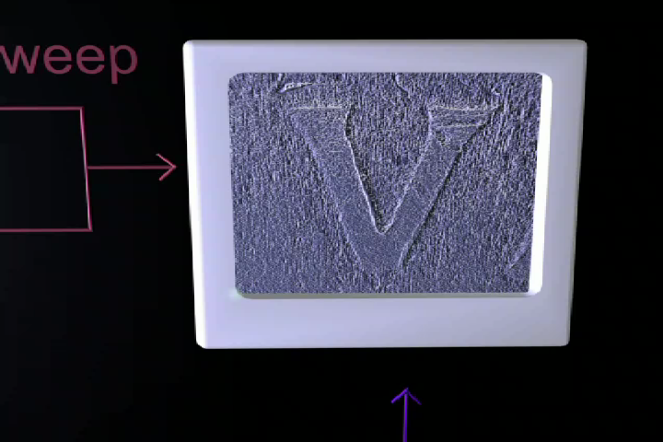
Small electromagnetic coils in last lens cycle current up and down
AC magnetic field scans e-beam across sample
"Secondary" electrons are emitted from the sample
Electron multiplier (cylinder) amplifies their signal
Different materials emit different numbers of
secondary electrons
Electrons from different shapes + slopes more or less likely to reach multiplier (huh? explain!)
Result: Get "contrasting" brightness point by point
Mapped into corresponding pixels on screen
(here real SEM image of 'V" on Virginia quarter coin)
A Hands-on Introduction to Nanoscience: WeCanFigureThisOut.org/NANO/Nano_home.htm

Slide 15
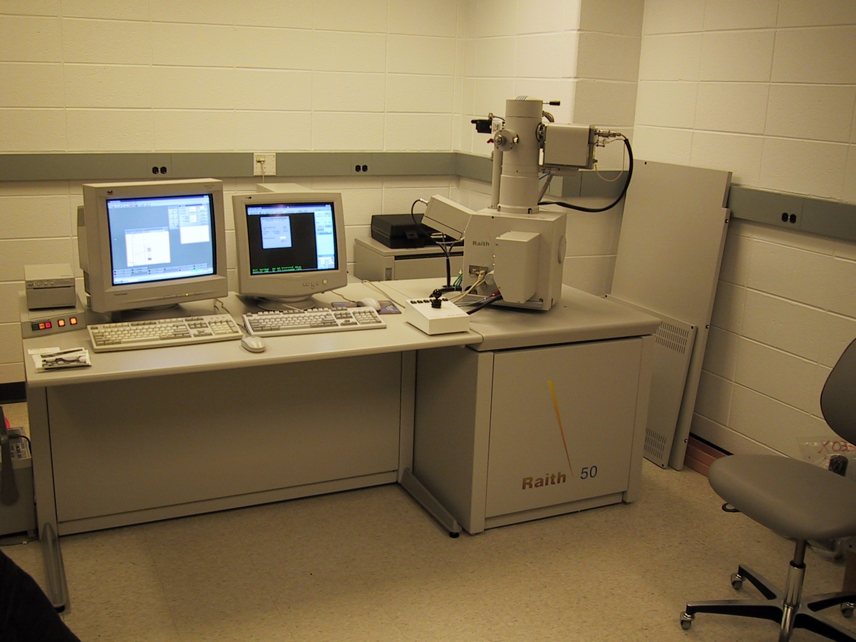
To convert SEM to e-beam lithography, you only need to:
Add a "beam blanker" = Means of rapidly turning beam off and on
You can just apply voltage to two parallel metal plates to slam beam off to the side!
Then add a computer to decide when the beam is to be on or off
For instance, based on CAD drawing of desired mask
Not surprisingly, result is an instrument
that looks almost identical to SEM!
(UVA's e-beam lithography system)
A Hands-on Introduction to Nanoscience: WeCanFigureThisOut.org/NANO/Nano_home.htm

Slide 16
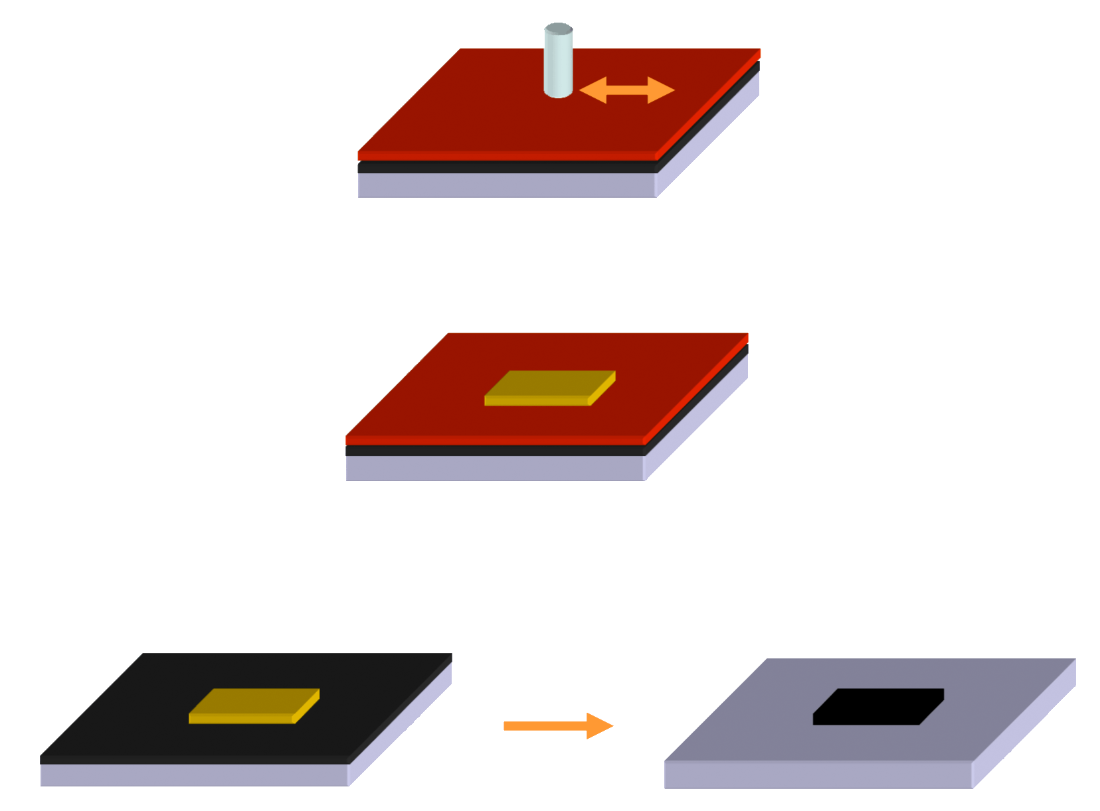
What has this got to do with making masks?
Scan e-beam across photoresist (polymer) covered, metal-coated, glass plate
Where beam was on, photoresist polymer is "exposed" (i.e. its bonding altered)
Works as well or better than UV:
e-beam has more energy!
Then "develop" photoresist pattern: The etch away unprotected metal:
A Hands-on Introduction to Nanoscience: WeCanFigureThisOut.org/NANO/Nano_home.htm

Slide 17
But did you spot key difference from earlier photolithography?
Photolithography printed entire integrated circuit at once!
All elements were printed "in parallel" across full circuit area:
E-beam lithography printed point by point
As e-beam was scanned "sequentially" or "serially" across mask:
But HERE serial e-beam write is OK:
Mask is created once, lasts a long time, is used to print 1000's of wafers!
E-beam → Computer programmed, ultra-fine patterning (to ~ nanometer scale)
So slow e-beam mask creation is still economically viable technology
Because we can afford slow expensive process for production of reusable masks!
A Hands-on Introduction to Nanoscience: WeCanFigureThisOut.org/NANO/Nano_home.htm

Slide 18
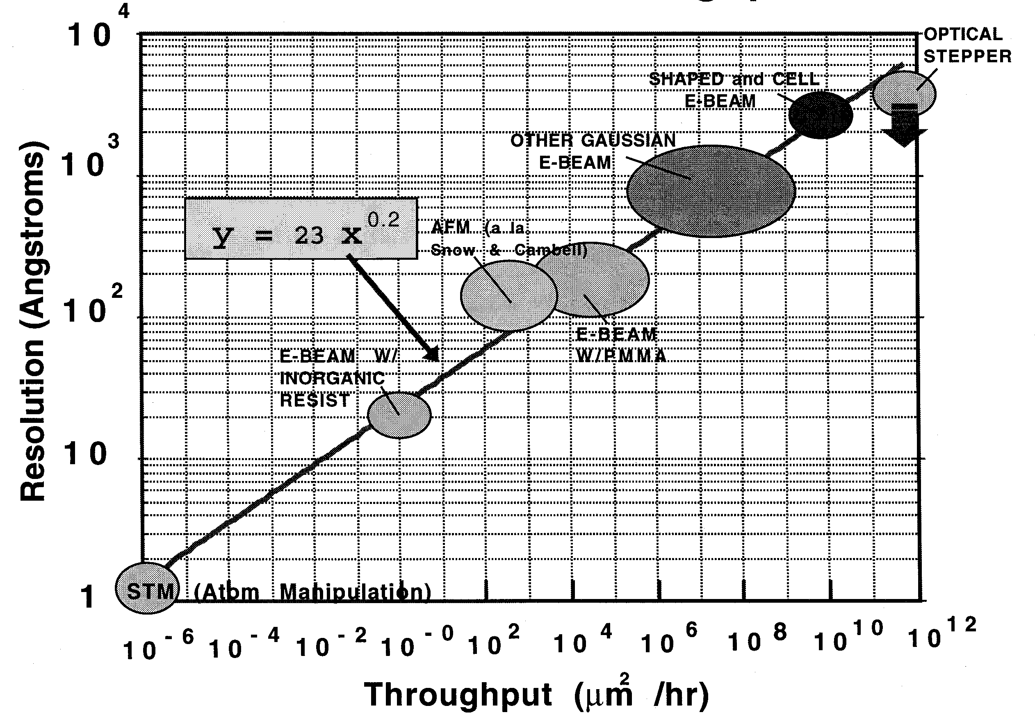
Photo vs. E-beam lithography patterning rates?
Source: Don Tennant
                (then at) Bell Labs
Assumes printing 50% of area
If area to be printed is
5x5 mm² =2.5 x 10⁷ um²
(~ single small circuit)
← Time to print that area
Photolithography
E-beam lithography
- 3000 Years
- 25 Hours
- 1/100 seconds
A Hands-on Introduction to Nanoscience: WeCanFigureThisOut.org/NANO/Nano_home.htm

Slide 19
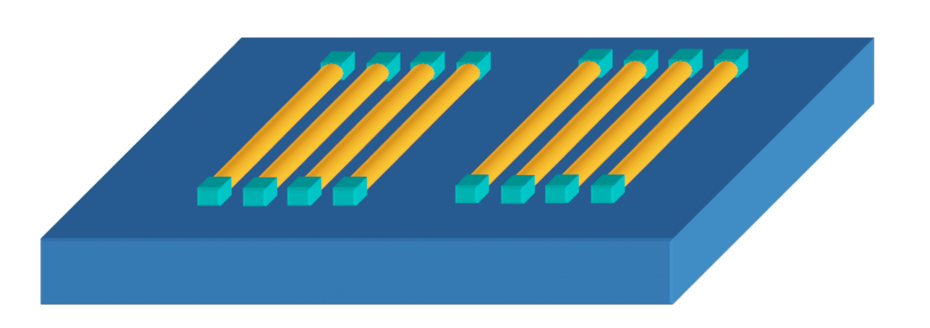
So both techniques = technology, right?
Applied as described above, YES But as often applied in nanoscience, NO!
E-beam lithography, with its resolution of ~ 1 nm is often used in nanoscience
I attended presentation on semiconductor nanowires:
Heard about clever techniques for growing these nanometer diameter wires
And new approaches for trying to float wires into position on circuit
Then speaker quickly mumbled "contacts made by high-resolution lithography" OOPS!!!
→ Slow serial e-beam, likely going into SEM imaging mode to FIND end of each wire!!
Was murmur through conference room as his "technology" crashed and burned!!!

Slide 20
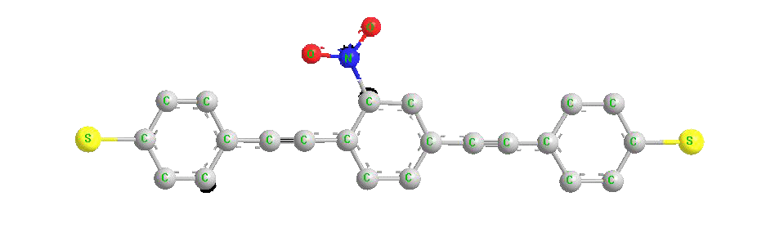
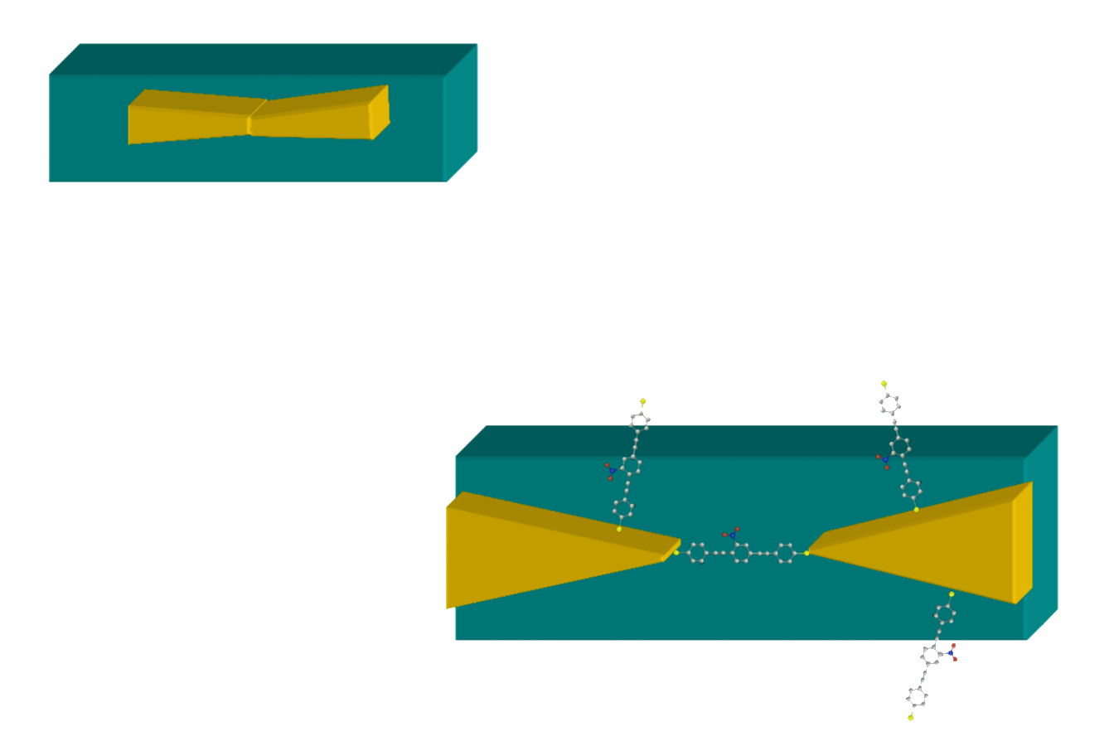
Further examples?
Rattner & Aviram 1974: Single organic molecules might = nano-electrical switch!
Proof? Mark Reed's 1997 "Break Junction:"
- Solution containing candidate molecules (yellow S atoms like Au):
- Plus nano-patterned gold line:
- Expand substrate (by heating, bending, or piezoelectric crystal) until gold is drawn apart
Continue until just ONE molecule fits in gap:
A Hands-on Introduction to Nanoscience: WeCanFigureThisOut.org/NANO/Nano_home.htm

Slide 21
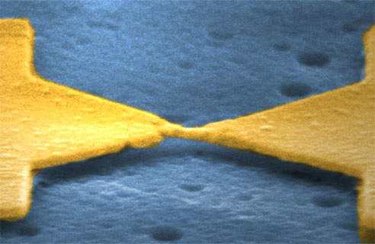
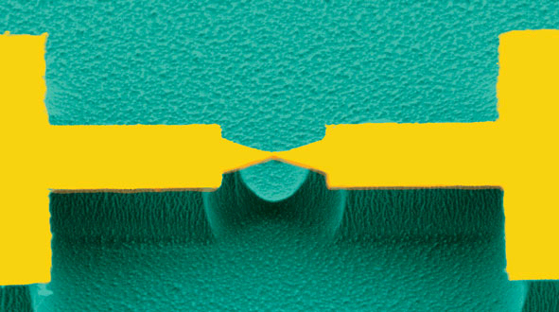
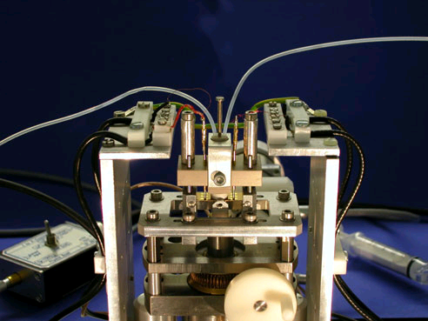
Photos of an actual break-junction setup:
High and low magnification SEM images of
unbroken break-junctions (left/center respectively)
Mechanism for pulling break-junction apart:
University of Basel: http://pages.unibas.ch/phys-meso/Pictures/pictures.html
INCREDIBLE SCIENCE! But is it technology? Absolutely not!
A Hands-on Introduction to Nanoscience: WeCanFigureThisOut.org/NANO/Nano_home.htm

Slide 22
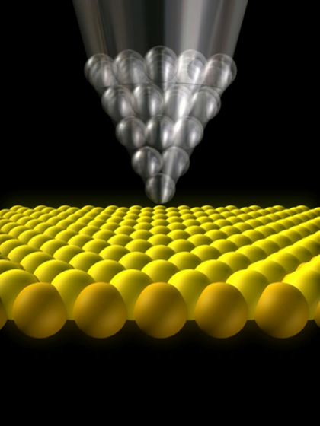
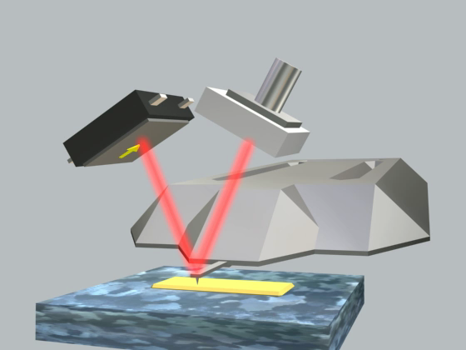
Investigators noted similar configuration in nanoscale tips of:
Scanning tunneling microscopes (STMs) Atomic Force Microscopes (AFMs)
Some inserted molecules into gaps (even as AFM tip bounced!) to study molecules
No problem - It's still great, powerful, science!
Some proposed memory cells based on STM Tips + Atoms/Molecules
Push atom/molecule into place for digital 1, remove it for digital 0
A Hands-on Introduction to Nanoscience: WeCanFigureThisOut.org/NANO/Nano_home.htm

Slide 23
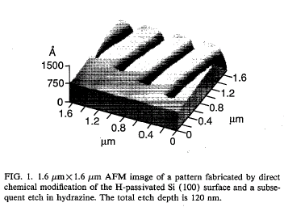

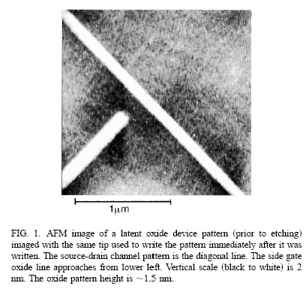
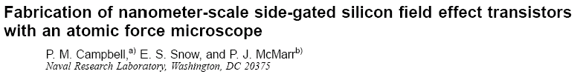
Others explored direct use of STM or AFM for lithography:
STM inducing point-by-point oxidation of silicon
→ Oxide pattern → Subsequent etch mask
(Applied Physics Letters 63, 749 (1993))
Same process applied using AFM to fabricate
prototype nano field-effect transistor
(Applied Physics Letters 66, 1338 (1995))
A Hands-on Introduction to Nanoscience: WeCanFigureThisOut.org/NANO/Nano_home.htm

Slide 24
Above was also great, even visionary, Nanoscience
NRL authors never claimed that STM or AFM writing was basis for Nanotechnology
But others HAVE suggested this . . . repeatedly . . . to this very day!!
Pushing atoms is also suggested as technology . . . repeatedly . . . to this very day!!
Saw another such paper + corporate press release in recent months!!
What is the exact problem?
To answer, must finally go to left end of figure I used earlier:
A Hands-on Introduction to Nanoscience: WeCanFigureThisOut.org/NANO/Nano_home.htm

Slide 25
Processing times for ALL lithographies:
Source: Don Tennant of Bell Labs
Again assume printed area is
5x5 mm² (=2.5 x 10⁷ um²):
TIMES FOR ONLY 5x5 mm²
Wafers now 300 mm across!
(~70,000 mm²)
→ 9000 billion years
Universe ~ 14 billion years!
E-beam lithography
Photolithography
AFM lithography
STM lithography
- 3 billion years
- 30 Years
- 3000 Years
- 25 Hours
- 1/100 seconds

Slide 26
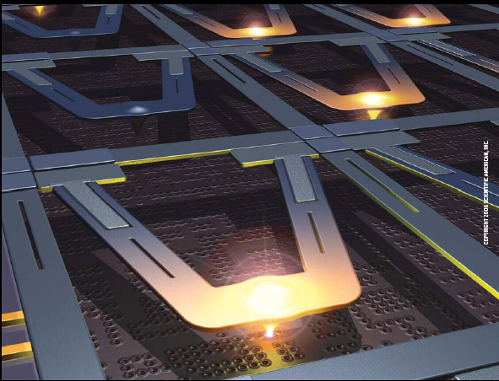
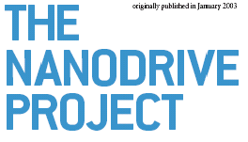
We're now experts at distinguishing good science from viable technology
So try this proposal on for size:
Proposed by IBM
Here described in Scientific American:
"The Nanotech Revolution" (2006)
A Hands-on Introduction to Nanoscience: WeCanFigureThisOut.org/NANO/Nano_home.htm

Slide 27
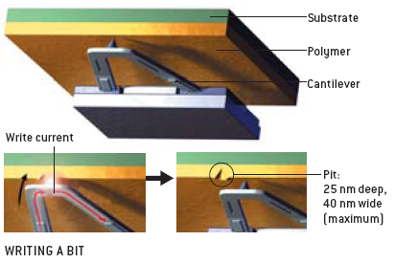
Which works (upside down) by:
1) Writing a bit by passing heat through cantilever to melt pit in polymer
Presumably upside down so dust/particles can’t fall on surface
Even though nanoparticles can "fall" upward when electrostatics overcome gravity!
(So really could have been done right side up with ~ same results)
Scientific American
"The Nanotech Revolution" (2006)
A Hands-on Introduction to Nanoscience: WeCanFigureThisOut.org/NANO/Nano_home.htm

Slide 28
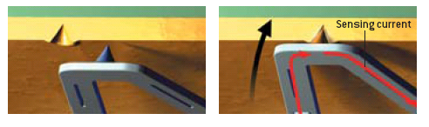
2) Read a bit by sensing when cantilever is cooled by falling into pit
By sensing the decrease in the heating element's resistance as it is cooled
Scientific American
"The Nanotech Revolution" (2006)
A Hands-on Introduction to Nanoscience: WeCanFigureThisOut.org/NANO/Nano_home.htm

Slide 29
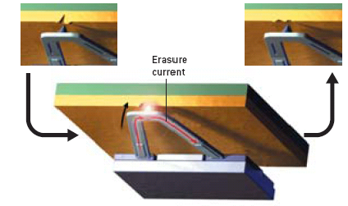
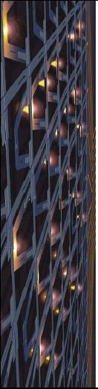
3) Erasing a bit by melting polymer adjacent to pit to ~ fill it in
And using a heck of a lot of these cantilevers in parallel
Scientific American
"The Nanotech Revolution" (2006)
A Hands-on Introduction to Nanoscience: WeCanFigureThisOut.org/NANO/Nano_home.htm

Slide 30
My take as a fellow researcher:
Their plan is to use slow "serial" point-by-point writing in "parallel" manner
That is, to use a glacially slow process
That I above calculated would take 30 YEARS to write one circuit
But to do this simultaneously at a WHOLE LOT of points
Detailed comments:
Basic write / read / erase idea for each cantilever seems sound
Microfabrication techniques are suitable for making cantilever arrays
Article stated that array of 1024 levers already fabricated!
But what if polymer sticks to a point?
So find a better polymer!!
Will points erode? (AFM probes erode after hours of continuous use)
Would limit lifetime number of read-write-erase cycles

Slide 31
My take having once hung with development engineers:
Generally, for an entire "circuit" to work, all devices in that circuit must work
Unless we use much more complex and costly "fault tolerant" designs
Say we wanted a really simple circuit involving only three devices
If there's 90% chance each device works, what is chance of whole circuit working?
(0.9) (0.9) (0.9) = (0.9) ³ = 0.72 => 72% "yield" of working circuits
But "getting real" I'd guess Intel wants circuit yields of at least 90%
And these days their circuits can easily have 100,000,000 devices per circuit
(X) ^{100,000,000} = 0.9 => X = 1 => 100% according to my calculator
Indicating that 90% circuit yield requires ~ 100% device yield

Slide 32
Again, trying to outsmart my calculator's rounding:
Put in explicit single device yields and calculate whole circuit yield:
Single device yield: 100,000,000 device circuit yield:
0.99 (0.99)^{100,000,000} = 0 => 0%
0.9999 (0.9999)^{100,000,000} = 0 => 0%
0.999999 (0.999999)^{100,000,000} = 3.7x10⁻⁴⁴ => ~0%
0.99999999 (0.99999999)^{100,000,000} = 0.368 => 36.8%
0.999999999 (0.99999999)^{100,000,000} = 0.905 => 90.5%
So EACH device must work with a 99.999999% probability for 90% circuit yield
"We're not in Kansas Anymore!" - A Hands-on Introduction to Nanoscience

Slide 33
Above is calculation every circuit development engineer knows well
It is WHY development engineers tend to be so cynical and pessimistic
But it is not a calculation most researchers truly appreciate
Unless some development engineer once hammered it into their head
As one such development engineer once did to me!
But it looks to me as if these IBM researchers have not had that experience
Because they are, in essence, still saying:
"But I got 1000 devices to work, why not 100,000,000?"
But YOU should now see that, while it is not impossible, is extemely improbable
Indeed, Intel and industry took FIFTY YEARS to get that good!
A Hands-on Introduction to Nanoscience: WeCanFigureThisOut.org/NANO/Nano_home.htm

Slide 34
Evidence one way or the other?
In 2006 IBM authors gave it: 50-50 odds of working within 3 years (i.e. by 2009)
2008: "I'm skeptical . . . But not sure I'd bet against IBM (co-inventors of AFM)"
2009: No news from IBM
2010: My private conversation with an IBM developer
Since: Absolutely nothing new on the web – draw your own conclusion
A Hands-on Introduction to Nanoscience: WeCanFigureThisOut.org/NANO/Nano_home.htm

Slide 35
Summary
Researchers have developed excellent nanoscience tools & techniques
Some of these are also suitable for limited nanotechnology roles
Prime example: E-beam lithography
Other tools are superb for nanoscience - but hopeless for nanotechnology
Prime examples: STM and AFM probes (at least as normally used)
But question of practicality can get REALLY MUDDY
As in visionary "Nanodrive Project"
So stay excited about nanotechnology - But also stay skeptical!
A Hands-on Introduction to Nanoscience: WeCanFigureThisOut.org/NANO/Nano_home.htm

Slide 36
Credits / Acknowledgements
Funding for this class was obtained from the National Science Foundation (under their Nanoscience Undergraduate Education program).
This set of notes was authored by John C. Bean who also created all figures not explicitly credited above.
Copyright John C. Bean
(However, permission is granted for use by individual instructors in non-profit academic institutions)
A Hands-on Introduction to Nanoscience: WeCanFigureThisOut.org/NANO/Nano_home.htm

